Slide 1
Web Design with HTML and CSS
Day 6

Slide 2
Discovering Tables
Tables
Compare data or outline a detailed topic in a compact format
Consist of rows, columns, and cells
Row – It is a horizontal line of information
Column – It is a vertical line of information
Cell – It is the intersection of a row and a column and usually contains data
The two types of cell are: a heading cell or a data cell
A heading cell typically displays text as bold and center-aligned
A data cell typically displays normal, left-aligned text and contains information appropriate for the column and row

Slide 3
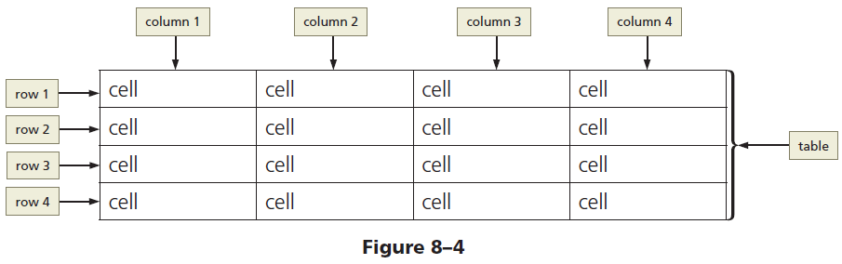
Discovering Tables (continued 2)
Figure 8–4 shows examples of the three elements: rows, columns, and cells

Slide 4
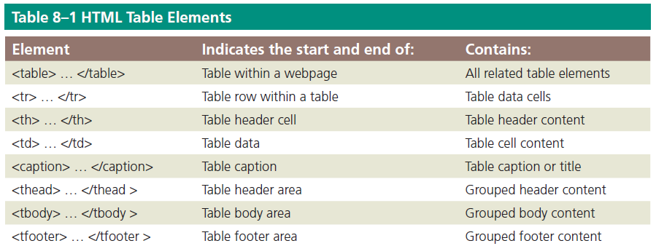
Creating a Table with HTML Elements
Table 8–1 lists the HTML elements used to create a table

Slide 5
Creating a Table with HTML Elements
Creating a table on a webpage
The <table> and </table> tags indicate the starting and ending of a table
The <tr> and </tr> tags indicate the starting and ending of each table row
The <td> and </td> tags indicate the starting and ending tags for data elements within the table row elements

Slide 6
Table Borders, Headers, and Captions
Table border – It is the line that defines the perimeter of the table
Table header
It is a heading cell and identifies the row or column content
It is defined with a starting <th> tag and an ending </th> tag

Slide 7
Table Borders, Headers, and Captions
Table caption
It is a descriptive text that serves as a title or identifies the table’s purpose
It is defined with a starting <caption> tag and an ending </caption> tag
It is inserted after the starting <table> tag
A table can have only one caption
Tables can include headers and captions individually or in combination

Slide 8
Table Borders, Headers, and Captions
How many columns does this HTML code generate?
How many headers?
How many rows?
<table>
<caption>College Course Recommendations by Semester</caption>
<tr>
<th>Semester 1</th>
<th>Semester 2</th>
<th>Semester 3</th>
<th>Semester 4</th>
</tr>
<tr>
<td>English I</td>
<td>English II</td>
<td>Spanish I</td>
<td>Spanish II</td>
</tr>
<tr>
<td>College Algebra</td>
<td>College Geometry</td>
<td>Calculus</td>
<td>Trigonometry</td>
</tr>
<tr>
<td>Physical Science</td>
<td>Biology</td>
<td>Humanities</td>
<td>World History</td>
</tr>
</table>

Slide 9
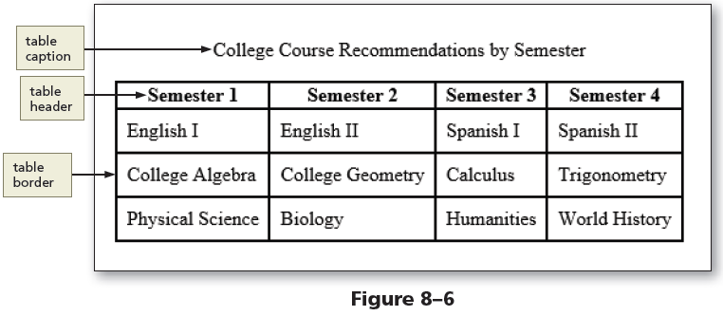
Table Borders, Headers, and Captions

Slide 10
Use of Tables
Tables
Display data in rows and columns
Should not be used to design a layout for a webpage
Help organize information so that it is easier for the user to read
Useful if the webpage needs to display a structured, organized list of information

Slide 11
Planning the Table
To create effective tables
Plan the information that will appear in columns and rows
Create a design that presents the information clearly
When planning a table for responsive web design, give careful consideration to the mobile viewport because of its screen size
Let’s create a new “Classes” page that can benefit from the creation of a table element.

Slide 12
Create the Classes Page
Open the “fitness.html” file from the “template” folder.
Save the file as “classes.html” (be sure to change folders so that this file is saved in the “fitness” root folder.)
Copy an image file that we will need for this page from the WA110 Data Files folder. (Found in the “Chapter 8” sub-folder and then the “fitness” sub-folder).
Copy the “classesBanner” image file and paste it into the “images” sub-folder in your “fitness” root folder.

Slide 13
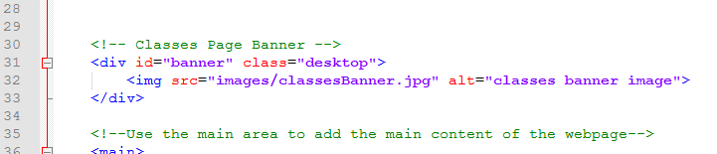
Create the Classes Page
Click on Line 28, press ENTER twice to insert new Lines 29 & 30.
On Line 30, press TAB to indent, then type <!-- Classes Page Banner --> to insert a comment.
Press ENTER to insert a new Line 31 and then type <div id=“banner” class=“desktop”> to insert a div tag.
Press ENTER to insert a new Line 32, increase the indent with TAB and then type the code shown to insert an image tag.
Press ENTER, decrease the indent on Line 33 and close the div with </div>. (If necessary, press ENTER again to give a blank line of space before the comment for the <main> element.)

Slide 14
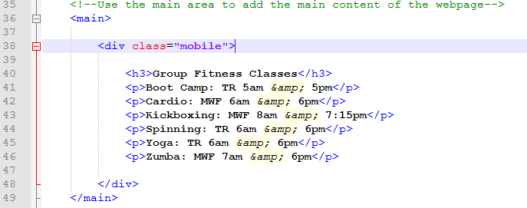
Add a div Element to the Classes Page
Click at the end of Line 36 and press ENTER twice to insert new Lines 37 & 38.
On Line 38, increase the indent with TAB and insert <div class=“mobile”>
Press ENTER twice to insert new Lines 39 & 40.
Press TAB to indent again, insert the code shown:

Slide 15
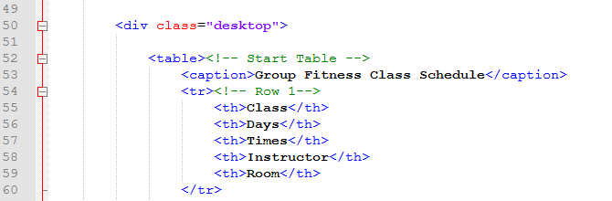
Add a table Element to the Classes Page
Click at the end of Line 48 and press ENTER twice to insert new Lines 49 & 50.
On Line 50 Insert the code & comments shown which will create a <div> element where we can add the <table> element.
(Pay attention to indents!)

Slide 16
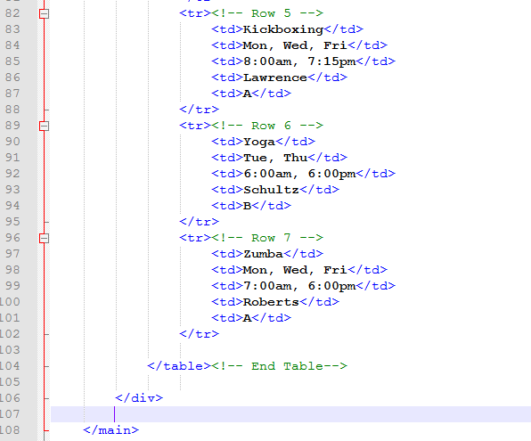
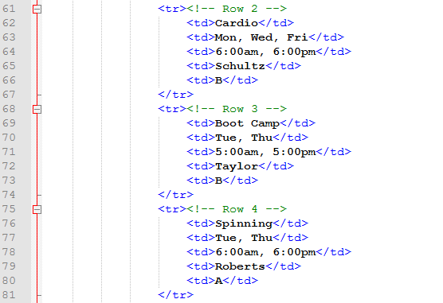
Add a table Element to the Classes Page
Enter the code & comments for the remaining rows as shown:

Slide 17
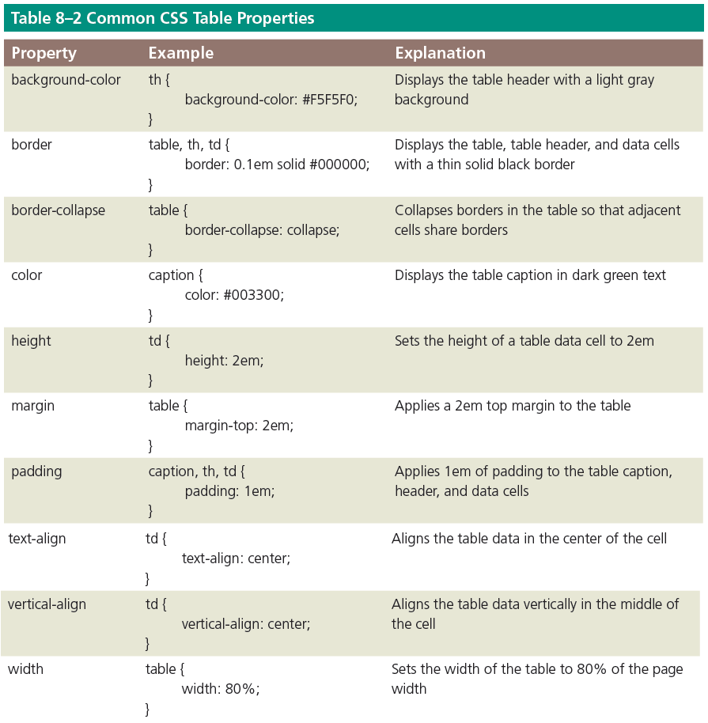
Styling Table Elements

Slide 18
Styling Table Elements
Separated border
When a border is applied to table elements, by default, each cell has its own border, making the table appear to use double lines between each table data cell
Collapsed border
Use the border-collapse property with a value of collapse to display a table with single, consolidated borders

Slide 19
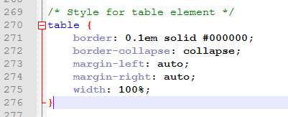
Styling a Table for a Tablet Viewport
Open the “styles.css” file in Notepadd++.
Click at the end of Line 267 and press ENTER twice to insert new Lines 268 & 269.
Enter the comments & code shown:

Slide 20
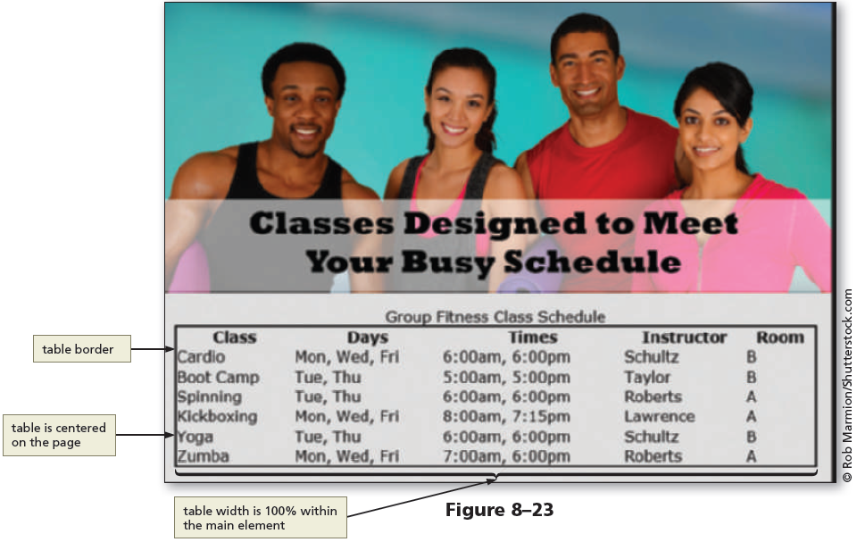
Styling a Table for a Tablet Viewport

Slide 21
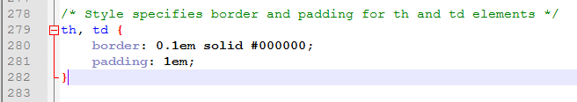
Styling a Table for a Tablet Viewport
At the end of Line 276, press ENTER twice to insert new Lines 277 & 278
On Line 278, enter the comment & code shown to style the <th> and <td> elements with borders and some padding for content.

Slide 22
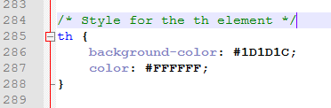
Styling a Table for a Tablet Viewport
Click at the end of Line 282 and press ENTER twice to insert new Lines 283 & 284.
Add the comment and code shown that will style the <th> element uniquely compared to the <td>

Slide 23
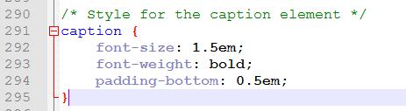
Styling a Table for a Tablet Viewport
Click at the end of Line 288 and press ENTER twice to insert new Lines 289 & 290.
Add the comment and code shown that will style the <caption> element.

Slide 24
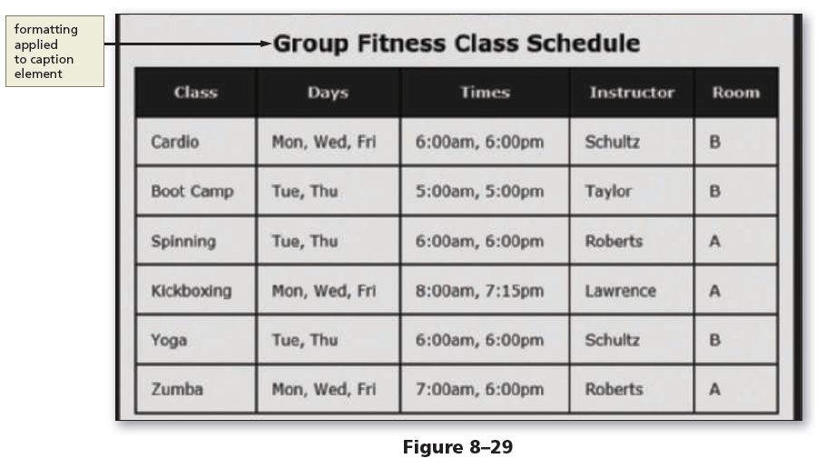
Styling a Table for a Tablet Viewport

Slide 25
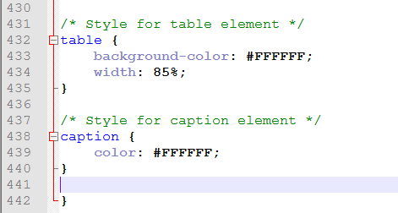
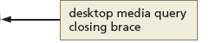
Styling a Table for a Desktop Viewport
In “styles.css” click at the end of Line 429 and press ENTER twice to insert new Lines 430 & 431.
On Line 431 add the comment and code shown to begin styling the table in a desktop viewport.

Slide 26
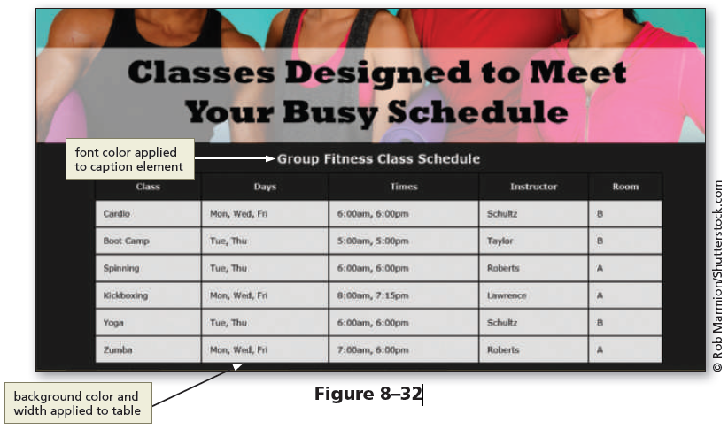
To Style a Table for a Desktop Viewport

Slide 27
COLSPAN
Table cells can span across more than one column or row. The attributes COLSPAN ("how many across") and ROWSPAN ("how many down") indicate how many columns or rows a cell should take up.
For example, we might want to create header cells for each department in our table of names and phone numbers. In this table, the header cells in the first and fifth rows span across two columns to indicate the department for each group of names.
http://www.htmlcodetutorial.com/tables/index_famsupp_30.html

Slide 28
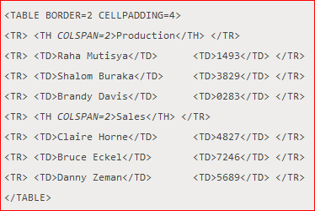
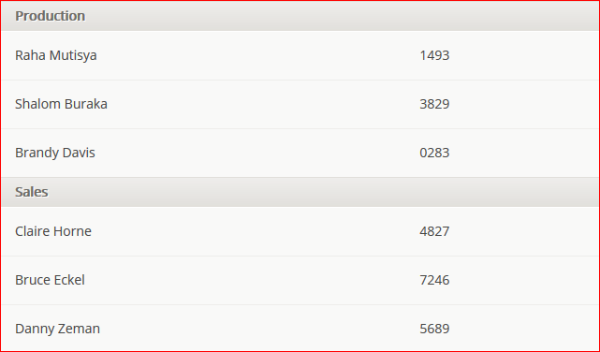
COLSPAN Example
http://www.htmlcodetutorial.com/tables/index_famsupp_30.html

Slide 29
ROWSPAN
ROWSPAN sets how many rows a cell spans.
ROWSPAN can get a little confusing because it requires you to think through how the cell affects the rows after the row it starts in. It's particularly useful in this situation to add borders to the table during the design process, even if the table won't ultimately use borders.
http://www.htmlcodetutorial.com/tables/index_famsupp_30.html

Slide 30
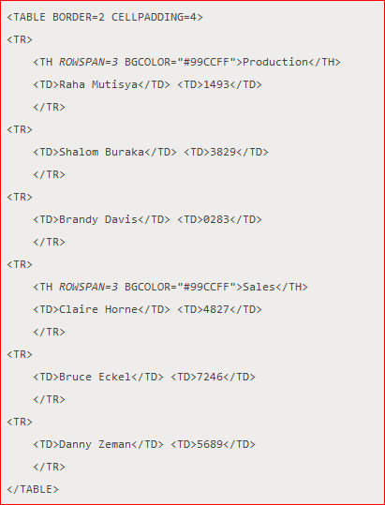
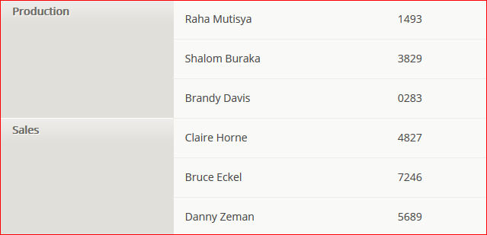
ROWSPAN Example
Note that in the two rows after each header, the first cell in the row ends up in the second column because the first column is taken up by the multi-column cell.
http://www.htmlcodetutorial.com/tables/index_famsupp_30.html

Slide 31
Exercise
Create an HTML table that looks as follows:
 | Header 1 | Header 2 | Header 3 | Header 4
Group 1 | Cell 1 | Cell 2 | Image 1
 | Cell 3 | Cell 3
 | Cell 5 | Cell 4
 | Cell 7 | Cell 5 | Subtotal | Total
Add tables to your web site project
Make sure the tables are optimized for three viewports:
Mobile
Tablet
Desktop

Slide 32
Creating Webpage Forms
Forms provide a structured way to collect information from webpage visitors
Visitors complete webpage forms to register for an account or to make a purchase.
Businesses use forms to gather visitor or customer information and store it in a database for future use

Slide 33
Form Controls
All form elements are contained with the starting <form> tag and the ending </form> tag
Input control – It is an interactive mechanism for users to enter text or make selections on a form
A label is text describing the type of information to enter with an input control.
Most controls in an HTML form are defined by using the type attribute of the input element

Slide 34
Form Controls
The two types of input controls are:
Data input control – It is used to make a selection or perform a command
Text input control – It accepts text, such as names, dates, and passwords, and is called an input field

Slide 35
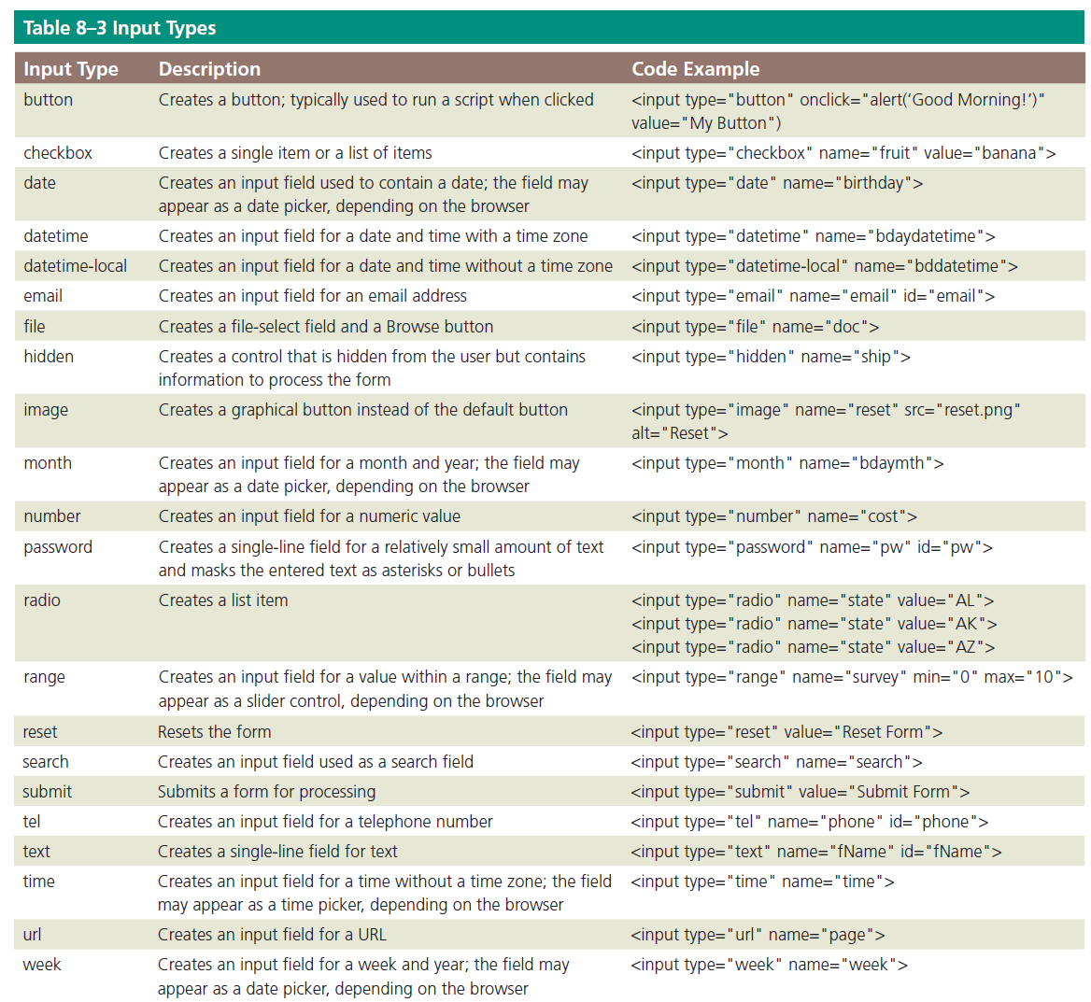

Slide 36
Form Controls
Each input control has attributes that are used more frequently than the others:
name – It identifies the specific information that is being sent when the form is submitted for processing. All controls have a name
id – It provides a unique ID for the element. Use the id attribute with input controls
value – It specifies the value of an input element and varies depending on input type

Slide 37
Form Controls
Common input controls used with a form include text, password, email, checkbox, select, submit, reset, etc.
Text input controls include the following types:
text box (text control), for small amounts of text
password text box (password control), for entering a password
email text box (email control), for entering an email address
telephone text box (tel control), for entering a telephone number
date text box (date control), for entering a date
text area box (textarea control), for larger amounts of text
These text input controls have two frequently used attributes:
size – It determines the width of the control in characters
maxlength – It specifies the maximum number of characters accepted

Slide 38
Form Controls
The first line of the following code creates a 25-character text box for the user’s last name and the second line creates an eight-character text box for the user’s password:
<p>Last Name: <input name="lastname" type="text“ size="25"></p>
<p>Password: <input name="password" type="password" size="8"></p>

Slide 39
Form Controls
Password control – It is a text control as it provides a text box for the password a visitor enters
Email control – It is a text box where visitors enter an email address
Tel control – It is a text box where visitors enter a telephone number
Date control – It is a text box that accepts a date

Slide 40
Form Controls
Textarea control – It creates a text box that allows multiple lines of input
To create a textarea control, use the textarea element instead of the input element
It has two primary attributes, which set the size of the textarea control:
rows, which specifies the number of rows, or lines, in the textarea control
cols, which sets the width of the textarea control as the number of columns, with each column containing one character

Slide 41
Form Controls
The following is an example of HTML code defining a textarea control:
<label>What products would you like to see us offer?</label>
<textarea name="feedback" rows="3“ cols="100"></textarea>

Slide 42
Form Controls
Checkbox control
It allows a webpage visitor to select items from a list of one or more choices
The following code is an example for two checkbox controls that might appear on a form for a grocery store website
<input name="fruit" type="checkbox" value="apple“ checked="checked">Apple
<input name="fruit" type="checkbox“ value="peach">Peach
What does checked="checked" mean?

Slide 43
Form Controls
Radio control
It limits the webpage visitor to only one choice from a list of choices
Each choice has a radio button, or option button, which appears as an open circle
By default, all radio buttons are deselected
To set a particular button as the default, use the checked attribute and value within the <input> tag

Slide 44
Form Controls
The following is sample code to create two radio controls that might appear in a rental car website form:
<input name="car" type="radio" checked="checked" value="car">Car
<input name="truck" type="radio" value="truck">Truck
A visitor can choose to rent a car or a truck, with the Car radio button already selected when the form opens

Slide 45
Form Controls
Select control
It creates a selection menu from which the visitor makes one or more choices and is suitable when a limited number of choices are available
It appears on a form as a text box with a list arrow
The following is sample code for a select control:
<select name="station">
<option>Pandora</option>
<option>Internet Radio</option>
<option>Live365</option>
<option>Jango</option>
</select>

Slide 46
Form Controls
Submit button
It sends the form information to the appropriate location for processing
When it is clicked on the form, the name of each control and the value of its data are sent to the server to be processed
The submit control is created with the following code:
<input type="submit“ value="Submit">

Slide 47
Form Controls
Reset button
Clears any input entered in the form, resetting the input controls to their defaults
A webpage form must include a submit control and a reset control
The value attribute specifies the text that appears on the button
The reset control is created with the following code:
<input type="reset" value="Reset">

Slide 48
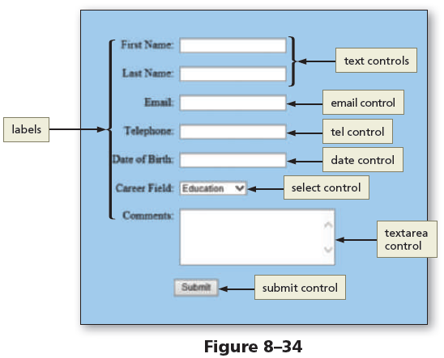
Form Controls
Figure 8–34 shows an example of a form with several input controls, including text, email, tel, date, select, and textarea

Slide 49
Form Controls
Form Labels
They identify the type of information to enter into or select from an input control
They are added to a form using the label element
To connect them to their controls, include the for attribute with the same value as the input control’s id value

Slide 50
Form Controls
The following code creates a label and a text box for a visitor’s first name:
<label for="fName">First Name:</label>
<input type="text" name="fName“ id="fName">

Slide 51
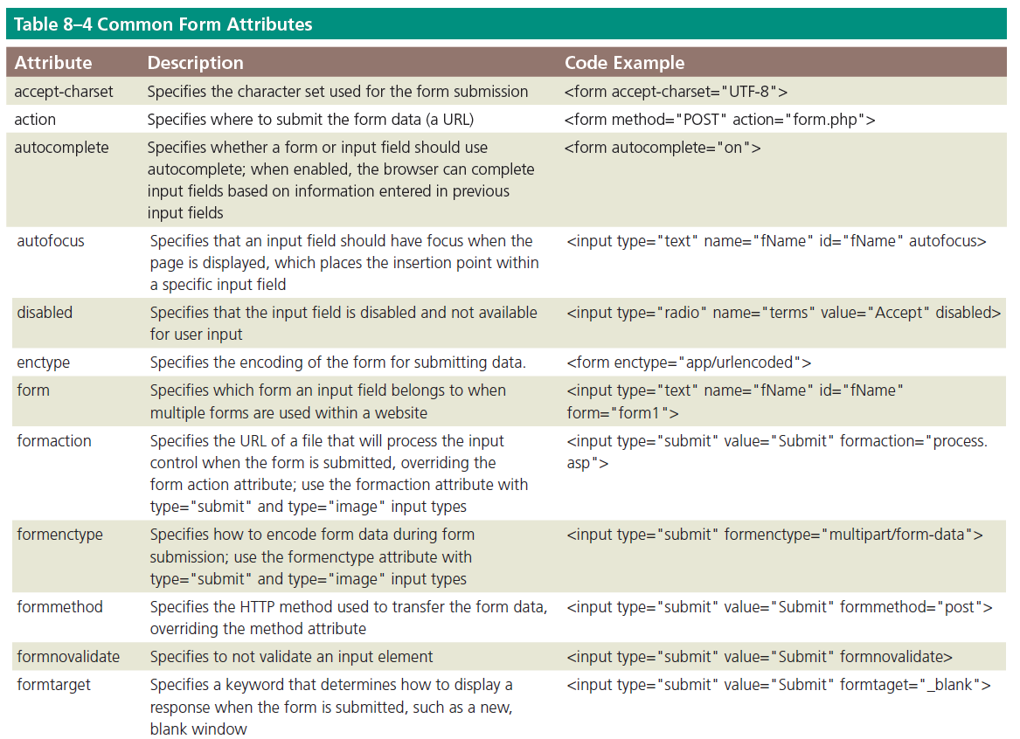
Form Controls

Slide 52
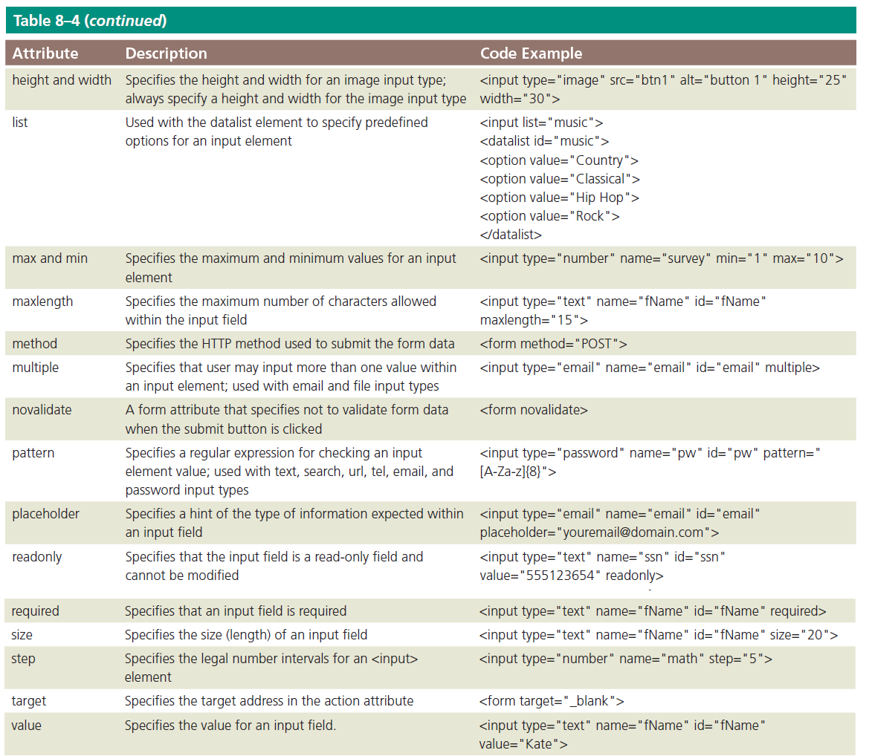
Form Controls

Slide 53
Form Processing
action
It is an attribute of the <form> tag that specifies the browser’s action when submitting the form
Common Gateway Interface (CGI) script
It communicates with the web server and sends the information on the webpage form to the server for processing

Slide 54
Form Processing
method
It is an attribute of the <form> tag that specifies how to send the data entered in the form to the server to be processed
Get method
It appends the name-value pairs to the URL indicated in the action attribute
Example of a form tag with the get method and specified action is as follows:
<form method="GET" action="formInfo.php">

Slide 55
Form Processing
Post method
It sends a separate data file with the name-value pairs to the URL indicated in the action attribute
It is used very commonly because it can be used to send sensitive form data and does not have a size limitation
Example of a form tag with the post method and specified action is as follows:
<form method="POST" action="formInfo.php">

Slide 56
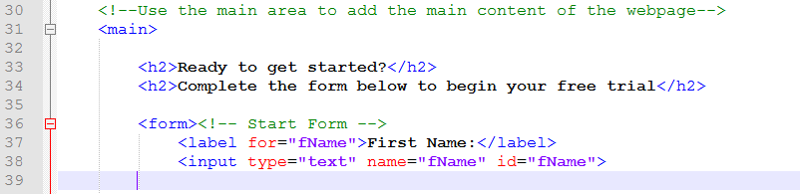
Add a Form, Labels, and Text Input Controls to the Contact Us Page
Open “contact.html” in Notepad ++.
On Line 33, DELETE the text “Contact us today.”
At the end of Line 33, press ENTER to insert a new Line 34.
On Line 34, enter the code shown to add a new <h2> element and start a form.

Slide 57
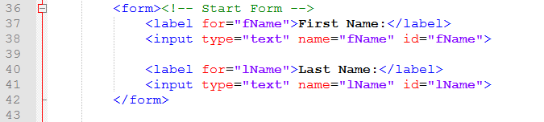
Add a Form, Labels, and Text Input Controls to the Contact Us Page
At the end of Line 38, press ENTER twice to insert new Lines 39 & 40.
Add the code shown to add a second label and text field and then the end tag </form>.

Slide 58
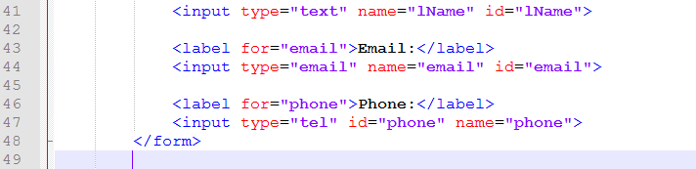
Add email and tel Input Controls to the Form
At the end of Line 41, press ENTER twice to insert new Lines 42 & 43.
Enter the code shown which will add the labels and controls for both an email and telephone input.

Slide 59
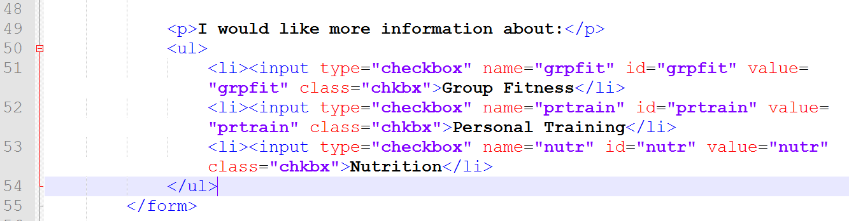
Add Check Boxes to a Form
Click at the end of Line 47 and press ENTER twice to insert Lines 48 & 49.
Enter the code to create a unordered list element that contains checkbox input elements.

Slide 60
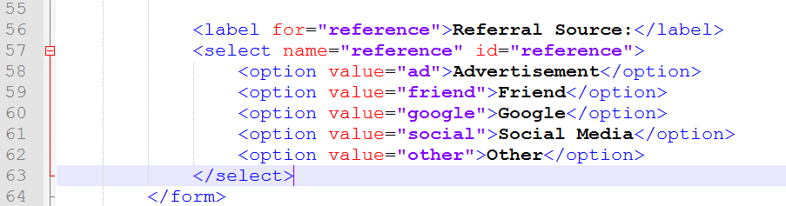
Add a Select Element to a Form
Click at the end of Line 54 and press ENTER twice to insert new Lines 55 & 56.
Enter the code shown which will create a select element where users can choose from a list of option value choices.

Slide 61
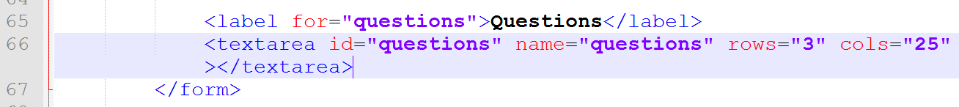
Add a textarea Element to a Form
Click at the end of Line 63 and press ENTER twice to insert new Lines 64 & 65.
Enter the code shown which will create a textarea element where users can type multiple lines of text.

Slide 62
Add a Submit and Reset Buttons to a Form
Click at the end of Line 66 and press ENTER twice to insert new Lines 67 & 68.
Enter the code shown which will create submit controls so users can submit as well as reset the information in the form.

Slide 63
Styling Forms
CSS styles are applied to forms to improve the appeal and usefulness of the form and its controls.
As with tables, consider forms in the context of responsive design.
Controls can be included to collect optional information, such as product feedback, in tablet and desktop viewports.

Slide 64
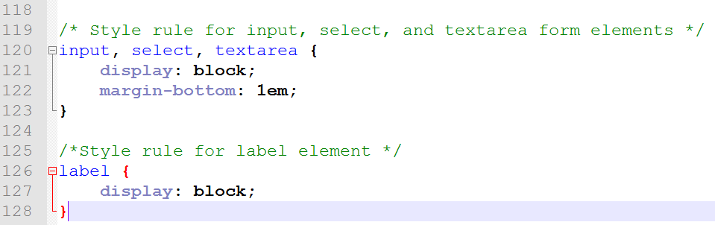
To Style a Form for a Mobile Viewport
Open “styles.css” in Notepad ++ if necessary.
Click at the end of Line 117 (the last line before the tablet media query) and press ENTER twice to insert new Lines 118 & 119.
Enter the comments and code shown to begin styling form elements.

Slide 65
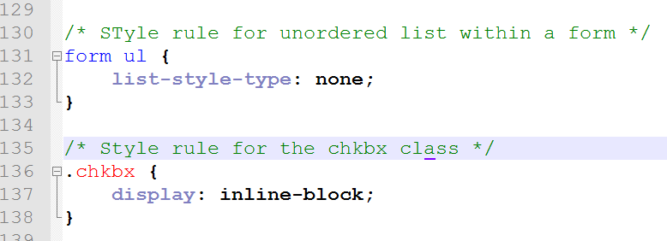
To Style a Form for a Mobile Viewport
At the end of Line 128, press ENTER twice to insert new Lines 129 & 130.
Enter the comment and code shown to style additional form elements.

Slide 66
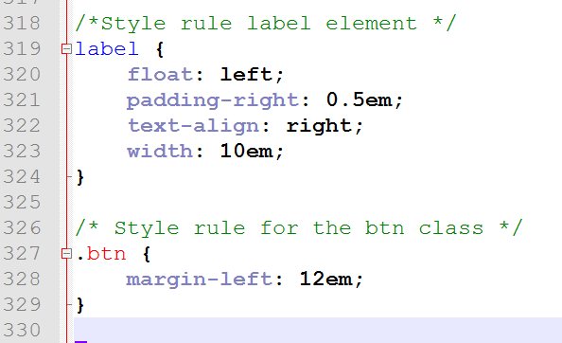
To Style a Form for a Tablet Viewport
At the end of Line 316, press ENTER twice to insert new Lines 317 & 318.
Enter the comment and code shown to style additional form elements for a tablet viewport.

Slide 67
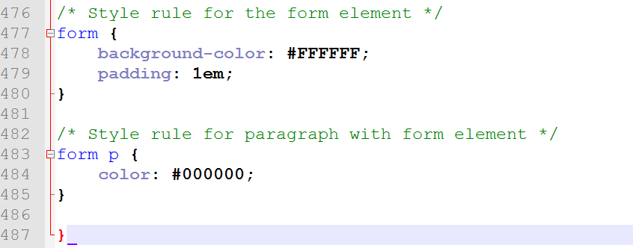
To Style a Form for a Desktop Viewport
At the end of Line 474, press ENTER twice to insert new Lines 475 & 476.
Enter the comment and code shown to style additional form elements for a desktop viewport.

Slide 68
Save & Validate
Validate the CSS at:
http://jigsaw.w3.org/css-validator/
Validate the HTML at:
https://validator.w3.org/

